Slide 1
Data Preprocessing, Evaluation of Classification & EDA
By Dr. Shagun Sharma

Slide 2
Contents
Data preprocessing:
Data cleaning – data integration – Data Reduction, Data Transformation and Data Discretization.
Evaluation of classification methods – Confusion matrix, Students T-tests and ROC curves-Exploratory
Data Analysis – Basic tools (plots, graphs and summary statistics) of EDA, Philosophy of EDA – The Data Science Process.

Slide 3
Data Preprocessing
Real-world data is often incomplete, noisy, and inconsistent, which can lead to incorrect results if used directly. Data preprocessing in data mining is the process of cleaning and preparing raw data so it can be used effectively for analysis and model building.
Real data contains missing and incorrect values
Data may come from multiple sources
Large datasets often have irrelevant information
Clean data gives better mining results

Slide 4
Data Preprocessing
Data preprocessing is the crucial, preliminary step in data analysis and machine learning that transforms raw, unstructured data into a clean, organized format. It involves techniques like cleaning (handling missing values/noise), transformation (normalization/scaling), and reduction to improve data quality, accuracy, and model performance.
Without this process, models may produce inaccurate, unreliable results due to poor-quality data. Examples include normalizing financial data, tokenizing text for Natural Language Processing (NLP), and reducing noise in images.

Slide 5
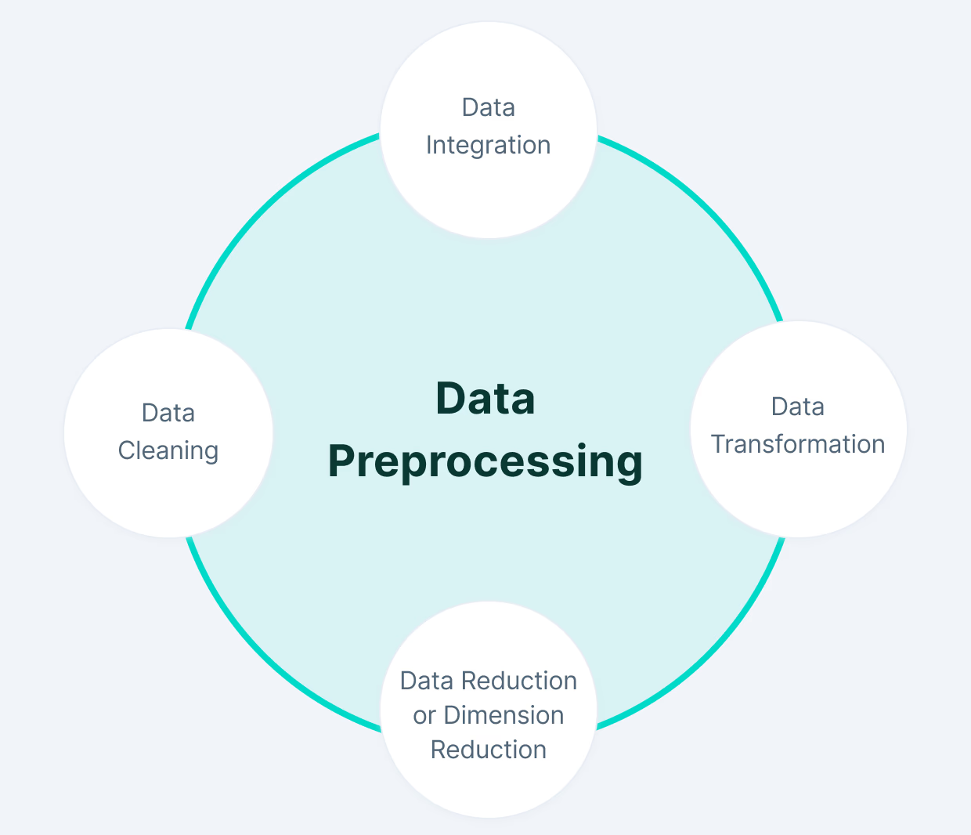
Data Preprocessing

Slide 6
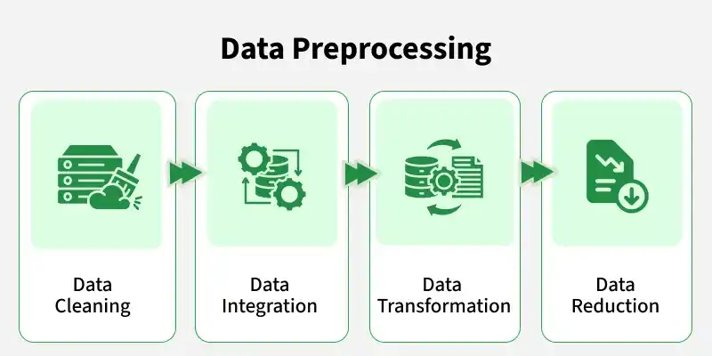
Steps of Data Preprocessing

Slide 7
Data Cleaning
It is the process of identifying and correcting errors or inconsistencies in the dataset. Its common tasks include:
Handling missing values
Removing duplicate records
Correcting wrong or inconsistent data
Handling Outliers

Slide 8
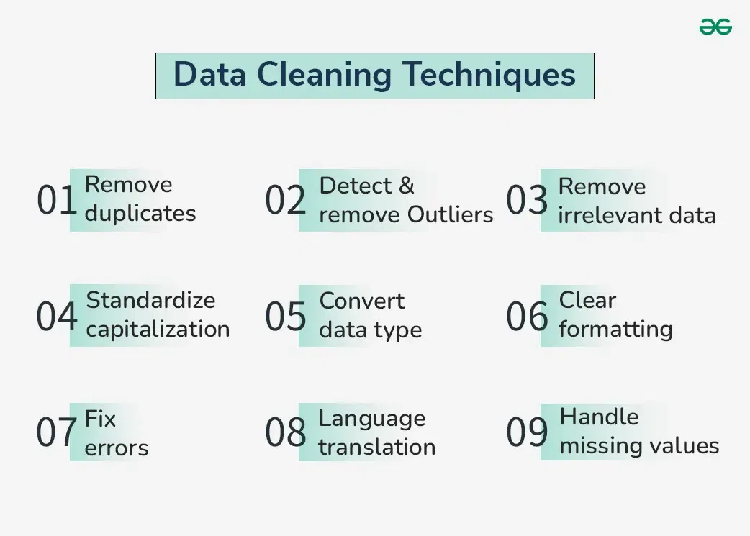
Data Cleaning

Slide 9
Techniques used in Data Cleaning
Techniques used:
Mean Imputation: Replaces missing values with the average of the attribute.
Median Imputation: Replaces missing values with the middle value, useful when outliers exist.
Mode Imputation: Replaces missing values with the most frequent value.
Deletion Method: Removes records that contain missing values.
Interquartile Range (IQR): Detects outliers using the range between Q1 and Q3.
Z-Score Method: Identifies outliers based on standard deviation from the mean.
Binning: Smooths noisy data by grouping values into bins.
Regression Smoothing: Uses regression to predict and smooth noisy values.
Duplicate Detection: Identifies and removes repeated records.

Slide 10
Example
Replacing missing age values with the average age
Removing repeated rows in a dataset

Slide 11
Sample table Example
Student_ID | Name | Age | Gender | Marks | Email
101 | Riya | 20 | F | 85 | riya@gmail.com
102 | Aman |  | M | 90 | aman@gmail
103 | NULL | 21 | Male | -5 | dev@gmail.com
103 | Dev | 21 | Male | -5 | dev@gmail.com
104 | Shreya | 200 | F | 88 | shreya@gmail.com
105 | Karan | 19 | m | 450 | karan@gmail.com
106 | Pooja | 20 | Female | 92

Slide 12
Sample table Example
Problems in Raw Data
Missing value → Age (Student 102)
Invalid email → "aman@gmail"
NULL name (Student 103)
Duplicate record → Student_ID 103
Invalid marks → -5 and 450
Invalid age → 200
Inconsistent gender → F, M, Male, m, Female
Missing email → Student 106

Slide 13
Sample table Example
Student_ID | Name | Age | Gender | Marks | Email
101 | Riya | 20 | Female | 85 | riya@gmail.com
102 | Aman | 20 | Male | 90 | aman@gmail.com
103 | Dev | 21 | Male | 0 | dev@gmail.com
104 | Shreya | 20 | Female | 88 | shreya@gmail.com
105 | Karan | 19 | Male | 100 | karan@gmail.com
106 | Pooja | 20 | Female | 92 | Not Available

Slide 14
Changes made
Problem | Cleaning Technique Used
Missing Age | Replaced with mean age (20)
NULL Name | Removed duplicate NULL row
Duplicate ID | Kept only valid record
Invalid Marks (-5) | Replaced with 0
Marks > 100 | Capped to 100
Age = 200 | Replaced with mean
Gender inconsistency | Standardized to Male/Female
Invalid email | Corrected format
Missing email | Filled with “Not Available”

Slide 15
Data Integration
Data Integration
It involves merging data from various sources into a single, unified dataset. It can be challenging due to differences in data formats, structures, and meanings.
Used when data comes from databases, files, or APIs
Removes redundancy between datasets
Resolves conflicts in data values

Slide 16
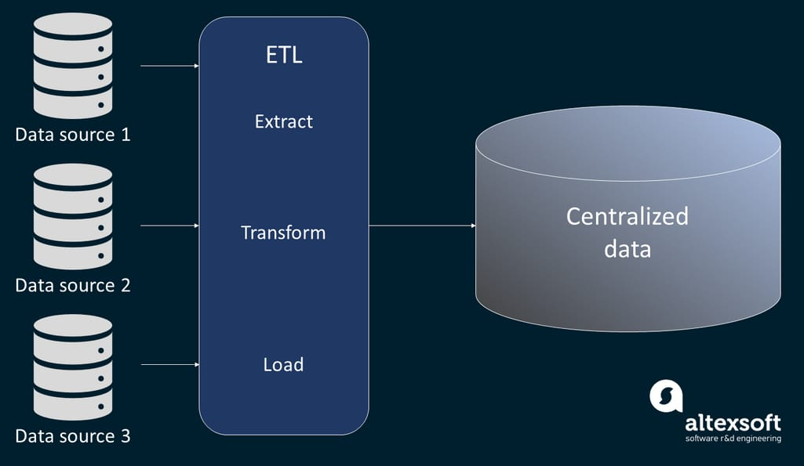
Data Integration

Slide 17
Techniques used for Data Integration
Techniques used:
Schema Matching: Aligns attributes from different data sources.
Entity Resolution: Identifies records that refer to the same real-world entity.
Correlation Analysis: Finds and removes redundant attributes.
Data Conflict Resolution: Resolves inconsistencies in units or data values.
Duplicate Elimination: Removes overlapping records after integration.
Example: Merging customer data from sales and marketing databases

Slide 18
Data Transformation
Data transformation converts data into a suitable form so that data mining algorithms can work effectively.
Bring data into a common format
Improve mining efficiency
Make data suitable for modeling

Slide 19
Data Transformation Techniques
Min-Max Normalization: Scales data into a fixed range, usually 0 to 1.
Z-Score Normalization: Transforms data using mean and standard deviation.
Decimal Scaling: Normalizes data by moving the decimal point.
Log Transformation: Reduces data skewness using logarithmic scaling.
One-Hot Encoding: Converts categories into binary columns.
Label Encoding: Assigns numeric labels to categorical values.
Aggregation: Combines detailed data into summarized form.

Slide 20
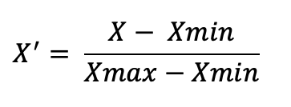
Min-Max Normalization
Student | Marks
A | 40
B | 60
C | 80
D | 100
Student | Normalized Marks
A | (40-40)/(100-40) = 0
B | 20/60 = 0.33
C | 40/60 = 0.67
D | 60/60 = 1
Here:
Min = 40
Max = 100

Slide 21
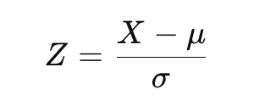
Z-Score Normalization
Student | Marks
A | 40
B | 60
C | 80
D | 100
Here:
Mean (μ) = 70

Slide 22
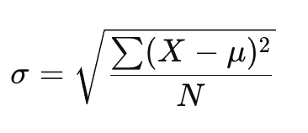

Z-Score Normalization
Marks (X) | X − 70 | (X − 70)²
40 | -30 | 900
60 | -10 | 100
80 | 10 | 100
100 | 30 | 900

Slide 23
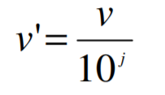
Decimal Scaling
Student | Marks
A | 45
B | 67
C | 89
Find Maximum Value
Max = 89
To make it less than 1, divide by 100
So, j = 2

Slide 24
Decimal Scaling
Student | Marks
A | 45
B | 67
C | 89
Apply Formula
Student | Original | After Decimal Scaling
A | 45 | 0.45
B | 67 | 0.67
C | 89 | 0.89

Slide 25
Solve this example with
Decimal Scaling
Salary
25000
50000
75000

Slide 26
Data Reduction
It reduces the dataset's size while maintaining key information. This can be done through feature selection which chooses the most relevant features and feature extraction which transforms the data into a lower-dimensional space while preserving important details.
Improves processing speed
Saves storage space
Makes analysis easier

Slide 27
Data Reduction Techniques
Principal Component Analysis (PCA): Reduces dimensions by projecting data onto principal components.
Linear Discriminant Analysis (LDA): Reduces dimensions while maximizing class separation.
Filter Methods: Select features based on statistical measures.
Wrapper Methods: Select features using model performance.
Embedded Methods: Perform feature selection during model training.
Simple Random Sampling: Selects data points randomly from the dataset.
Stratified Sampling: Samples data proportionally from each class.

Slide 28
Benefits of Data Preprocessing
Improves data quality
Increases accuracy of mining results
Reduces errors in models
Makes data easier to understand

Slide 29
Data Discretization
Data discretization is a preprocessing technique that converts continuous, quantitative data into discrete, categorical bins or intervals. It reduces data volume, improves model performance, and enhances interpretability by turning precise, high-cardinality numbers into meaningful, ranked groups (e.g., converting exact ages to "child," "adult," "senior"). Common techniques include binning, histogram analysis, and clustering.

Slide 30
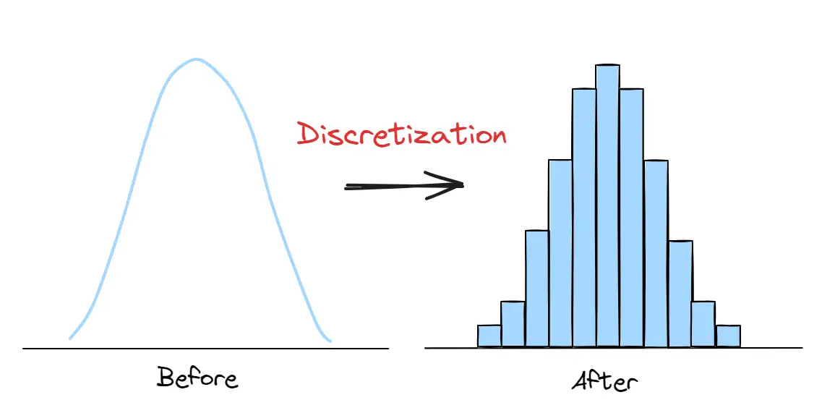
Data Discretization

Slide 31
Data Discretization Example
Student | Age
A | 18
B | 22
C | 35
D | 42
E | 60
Student | Age | Age Group
A | 18 | Young
B | 22 | Adult
C | 35 | Adult
D | 42 | Senior
E | 60 | Senior
We will create age groups:
0–20 → Young
21–40 → Adult
41–60 → Senior

Slide 32
Solve it!
Marks | Grade
35 | ?
55 | ?
72 | ?
90 | ?
35 | ?
Marks
35
55
72
90

Slide 33
Advantages of Data Preprocessing
Improved Data Quality: Ensures data is clean, consistent, and reliable for analysis.
Better Model Performance: Reduces noise and irrelevant data, leading to more accurate predictions and insights.
Efficient Data Analysis: Streamlines data for faster and easier processing.
Enhanced Decision-Making: Provides clear and well-organized data for better business decisions.

Slide 34
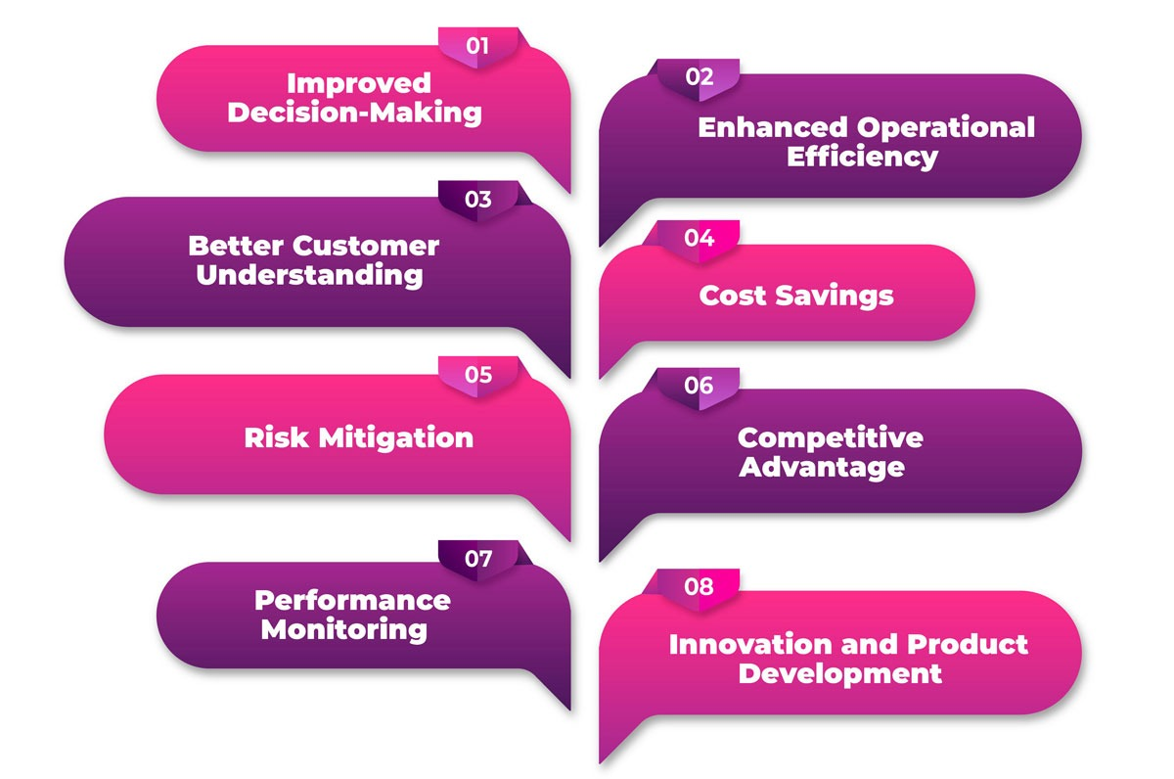
Advantages of Data Preprocessing

Slide 35
Evaluation of Classification Methods

Slide 36
What is Evaluation of Classification Methods?
Measuring how well a classification model is performing.
Example:
Spam vs Not Spam
Disease vs No Disease
Pass vs Fail

Slide 37
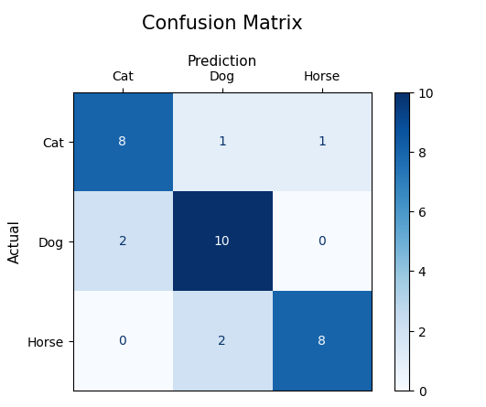
Confusion Matrix

Slide 38
Confusion Matrix
 | Predicted Yes | Predicted No
Actual Yes | 50 | 10
Actual No | 5 | 35

Slide 39
Four Terms in Confusion Matrix
TP (True Positive) = 50
Correctly predicted disease
FN (False Negative) = 10
Disease but predicted No
FP (False Positive) = 5
No disease but predicted Yes
TN (True Negative) = 35
Correctly predicted No disease
Example: FP
🔹 False
→ Model is wrong
🔹 Positive
→ Model predicted Positive (Yes)

Slide 40
Confusion Matrix
Metric | Meaning
TP | Model predicted Positive, actually Positive
FP | Model predicted Positive, actually Negative
FN | Model predicted Negative, actually Positive
TN | Model predicted Negative, actually Negative
 | Predicted Yes | Predicted No
Actual Yes | TP = 50 | FN = 10
Actual No | FP = 5 | TN = 35

Slide 41
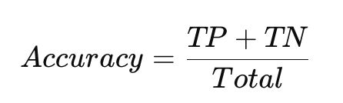
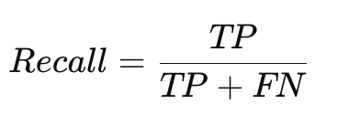
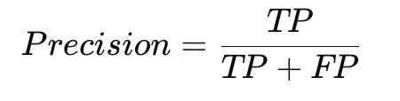
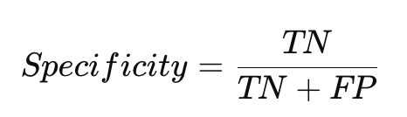
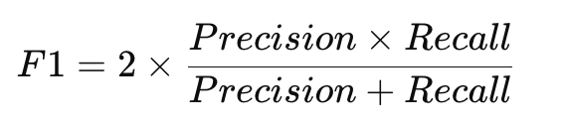
Metrics in Confusion Matrix

Slide 42
Student’s T-Test

Slide 43
Student’s T-Test
A t-test (also known as Student's t-test) is a tool for evaluating the means of one or two populations using hypothesis testing. A t-test may be used to evaluate whether a single group differs from a known value (a one-sample t-test), whether two groups differ from each other (an independent two-sample t-test), or whether there is a significant difference in paired measurements (a paired, or dependent samples t-test).
α Value | Meaning | Usage
0.10 | 10% error allowed | Exploratory studies
0.05 | 5% error allowed | Most common in research
0.01 | 1% error allowed | Very strict studies

Slide 44
Pre-defined T-Table
df | α = 0.10 | α = 0.05 | α = 0.02 | α = 0.01
1 | 6.314 | 12.706 | 31.821 | 63.657
2 | 2.920 | 4.303 | 6.965 | 9.925
3 | 2.353 | 3.182 | 4.541 | 5.841
4 | 2.132 | 2.776 | 3.747 | 4.604
5 | 2.015 | 2.571 | 3.365 | 4.032
6 | 1.943 | 2.447 | 3.143 | 3.707
7 | 1.895 | 2.365 | 2.998 | 3.499
8 | 1.860 | 2.306 | 2.896 | 3.355
9 | 1.833 | 2.262 | 2.821 | 3.250
10 | 1.812 | 2.228 | 2.764 | 3.169
20 | 1.725 | 2.086 | 2.528 | 2.845
30 | 1.697 | 2.042 | 2.457 | 2.750
∞ | 1.645 | 1.960 | 2.326 | 2.576

Slide 45
Example
A teacher claims that the average marks of students is 50.
A sample of 5 students has marks:
52, 48, 55, 49, 46
At α = 0.05, test whether the true mean is different from 50.

Slide 46
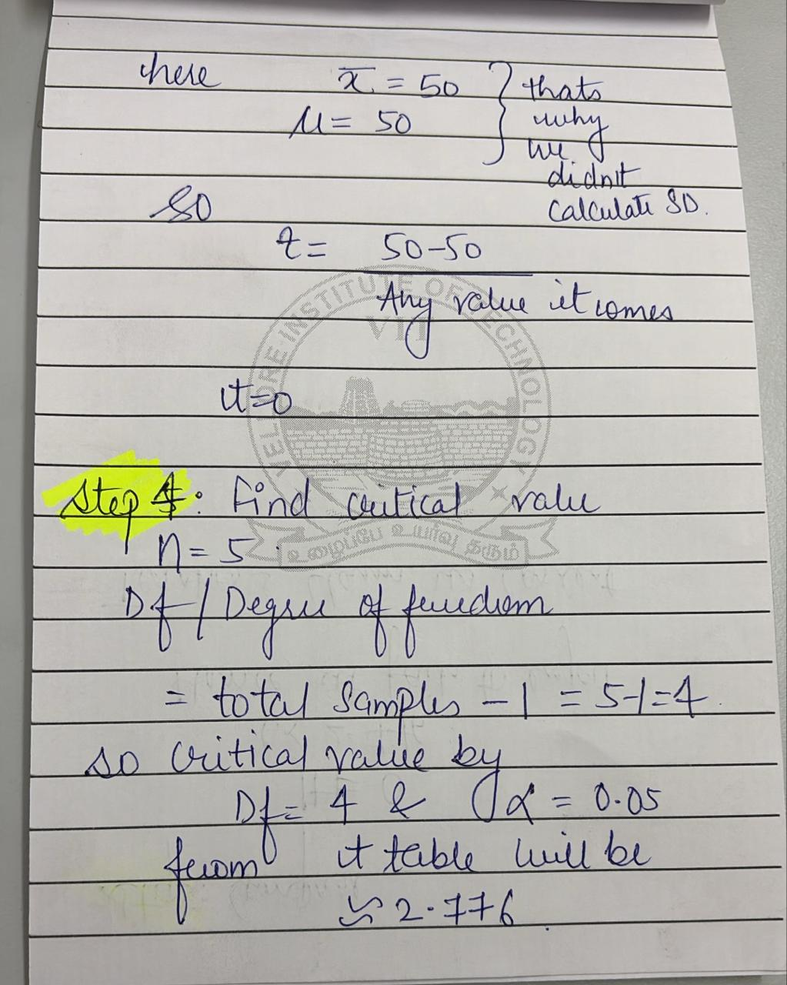
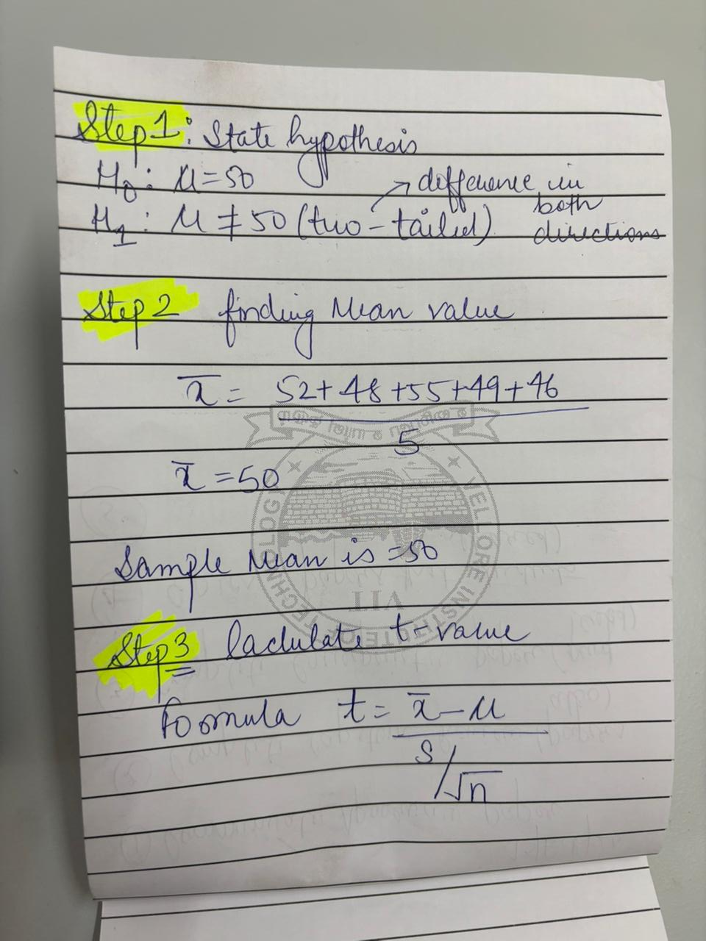
Solution

Slide 47

Solution

Slide 48
Solve it yourself!
A company claims that a machine fills bottles with an average of 500 ml.
You suspect the machine may be filling too much or too little.
You collect a sample of 6 bottles:
502, 498, 505, 497, 501, 496
Test at α = 0.05 whether the true mean is different from 500 ml.

Slide 49
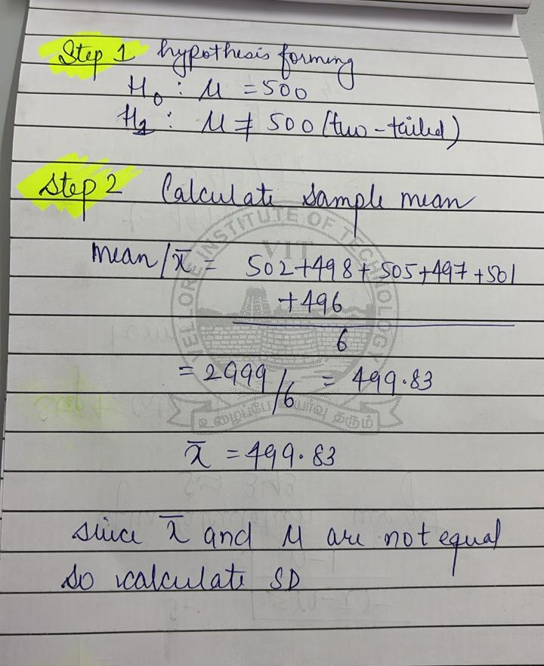
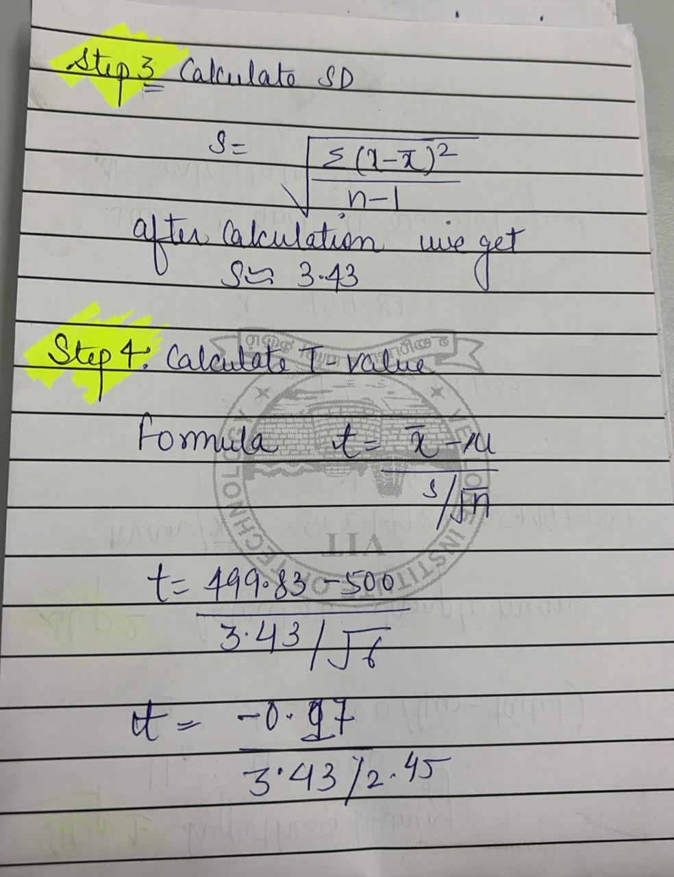
Solve it yourself!

Slide 50
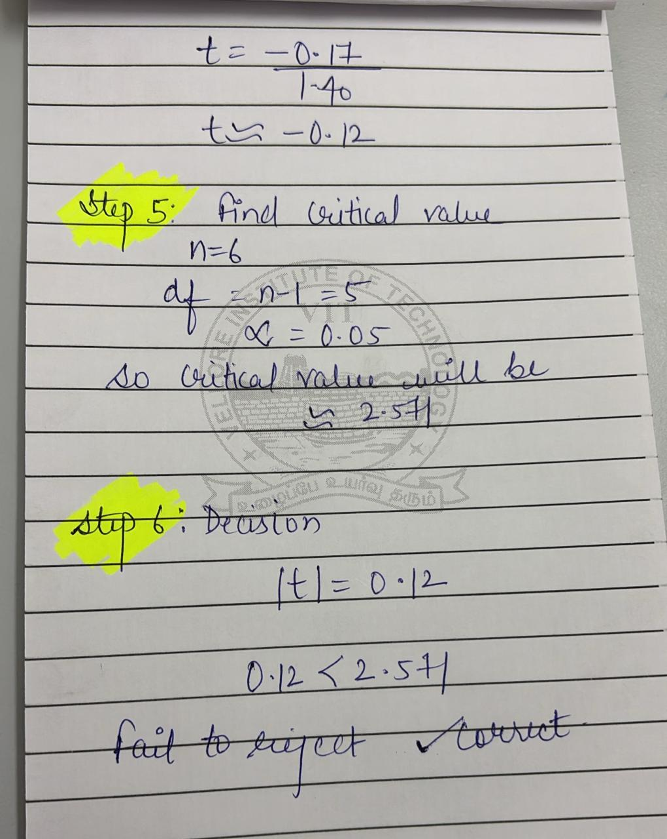
Solve it yourself!

Slide 51
Solve it yourself!
A factory claims that the average lifetime of its batteries is 100 hours.
A random sample of 8 batteries gives the following lifetimes (in hours):
98, 102, 95, 101, 99, 97, 103, 96
At α = 0.05, test whether the true mean lifetime is different from 100 hours.

Slide 52
ROC Curve
The Receiver Operating Characteristic (ROC) curve is a graphical evaluation tool used to assess the performance of a binary classification model.
It illustrates the trade-off between the True Positive Rate (TPR), also known as sensitivity or recall, and the False Positive Rate (FPR) at various threshold settings.
The TPR measures the proportion of actual positive cases that are correctly identified by the model, while the FPR measures the proportion of actual negative cases that are incorrectly classified as positive.
By plotting FPR on the x-axis and TPR on the y-axis, the ROC curve shows how well the classifier distinguishes between the two classes.

Slide 53
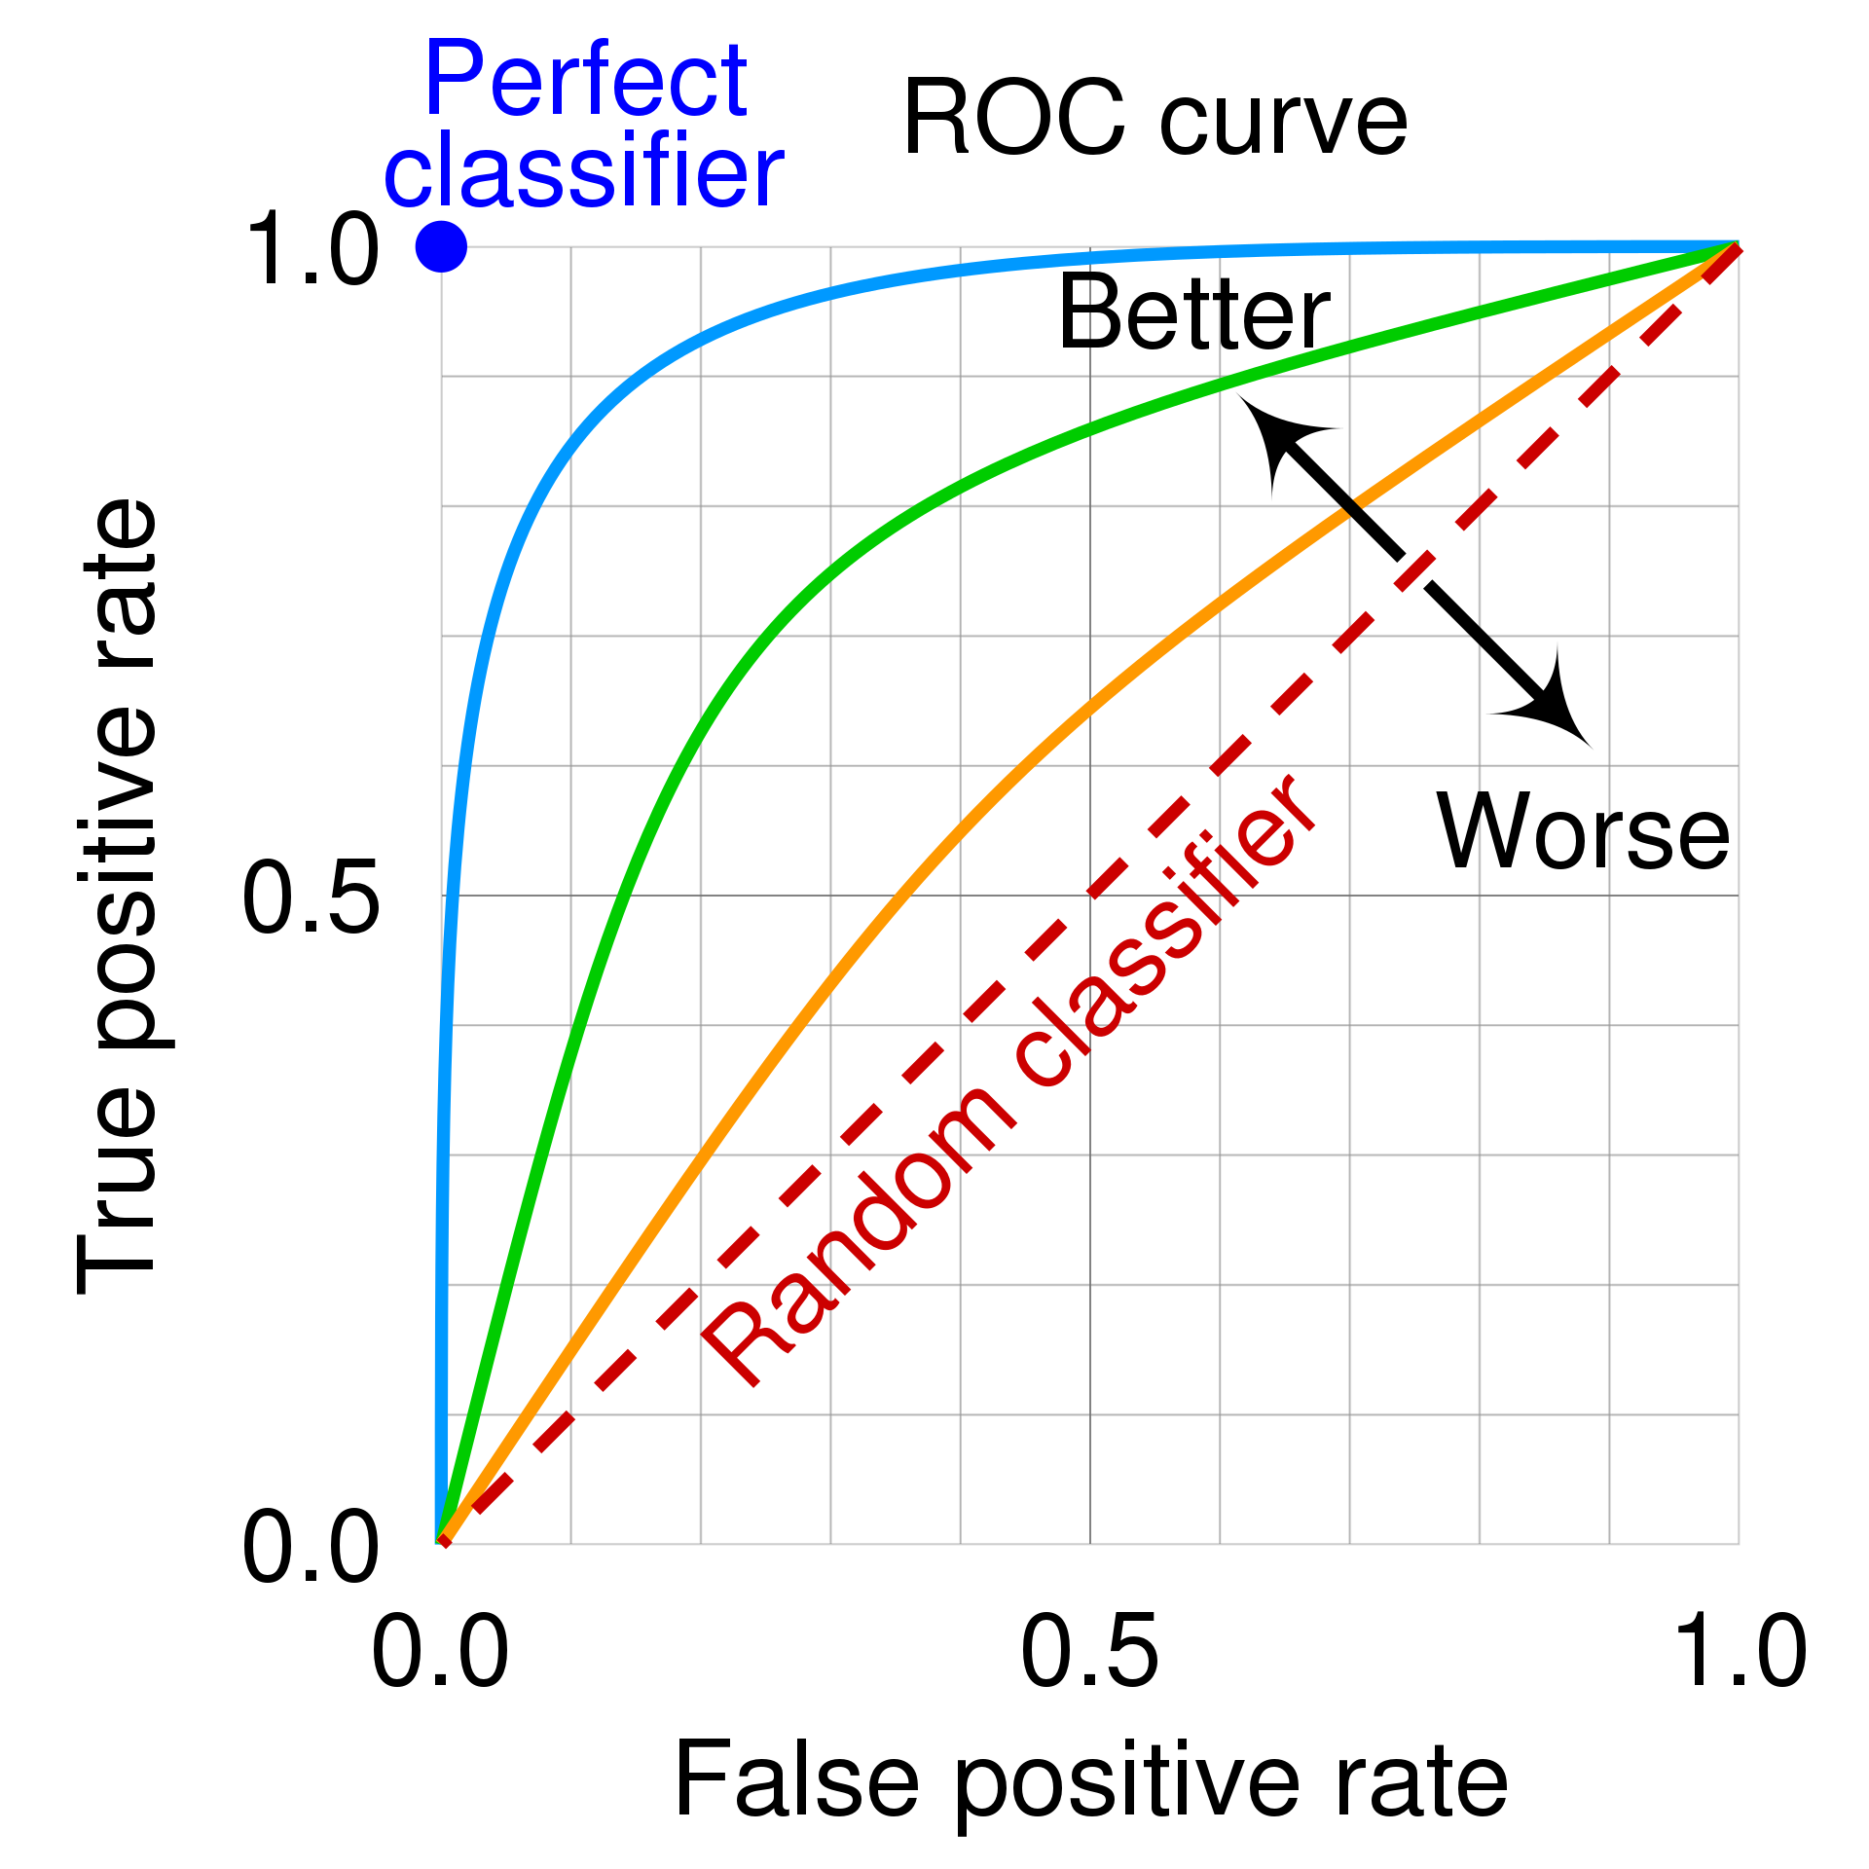
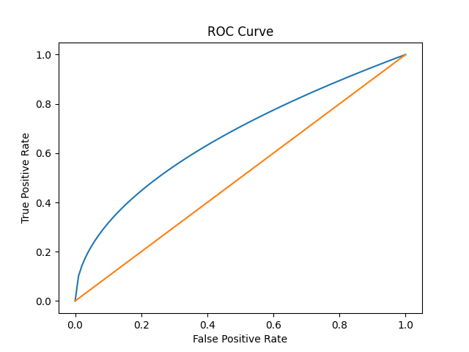
ROC Curve

Slide 54
ROC Curve
An important metric associated with the ROC curve is the Area Under the Curve (AUC). The AUC provides a single numerical value representing the model’s overall performance.
A model with an AUC value close to 1 indicates excellent discriminative ability, whereas an AUC of 0.5 suggests that the model performs no better than random guessing.
ROC curves are particularly useful in fields such as medical diagnosis, fraud detection, and risk prediction, where evaluating the trade-off between sensitivity and specificity is critical.

Slide 55
EDA (Exploratory Data Analysis)
Exploratory Data Analysis (EDA) is the process of analyzing datasets to summarize their main characteristics, often using visual and statistical methods.
It is performed before applying formal modeling or hypothesis testing techniques.
The primary goal of EDA is to understand the structure of the data, identify patterns and relationships, detect anomalies or outliers, and verify assumptions.
By exploring the dataset, researchers gain insights that guide further analysis and model development.

Slide 56
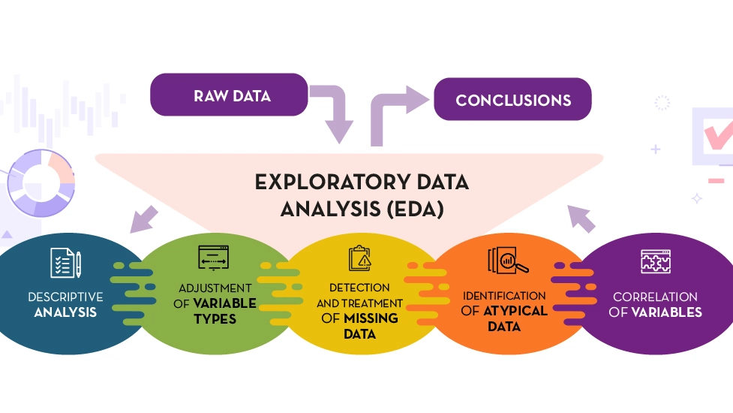
EDA (Exploratory Data Analysis)

Slide 57
Key Aspects of EDA
Data Cleaning & Preprocessing: Identifying missing values, duplicate data, and structural errors.
Descriptive Statistics: Summarizing data using metrics like mean, median, mode, and standard deviation.
Data Visualization: Using charts such as histograms, scatter plots, box plots, and heatmaps to visualize distributions and relationships.
Outlier Detection: Identifying anomalies that could skew analysis.
Correlation Analysis: Understanding relationships between variables (e.g., Pearson correlation).

Slide 58
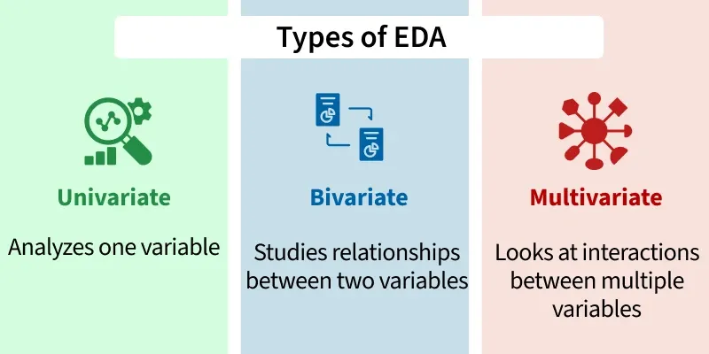
Main Techniques Used in EDA
Univariate Analysis: Analyzing a single variable to understand its distribution (e.g., histograms).
Bivariate/Multivariate Analysis: Investigating relationships between two or more variables (e.g., scatter plots, heatmaps).

Slide 59
Philosophy of Exploratory Data Analysis
The philosophy of Exploratory Data Analysis emphasizes understanding data before applying complex statistical models.
This approach was strongly promoted by John Tukey, who believed that data analysis should focus on discovering patterns and insights rather than merely confirming predefined hypotheses.
According to this philosophy, analysts should allow the data to reveal its structure through visualization and open-minded exploration.

Slide 60
Basic Tools of EDA
Plots: Histogram, Boxplot, Scatterplot.
Graphs: Line charts, Bar charts.
Summary statistics: Mean, Median, Std Dev.

Slide 61
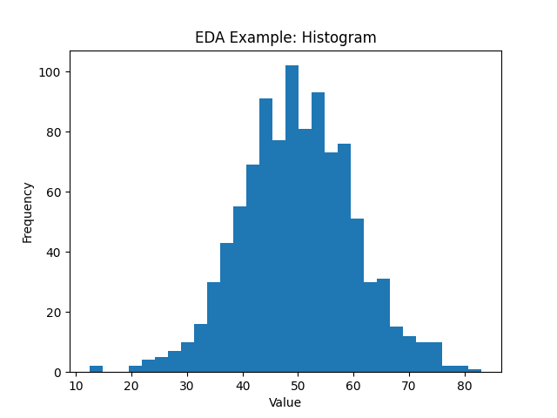
EDA Histogram Example
Histogram helps visualize distribution of data.

Slide 62
The Data Science Process
The Data Science Process is a structured framework that guides the transformation of raw data into actionable insights.
It typically begins with problem definition, where the objective and scope of the analysis are clearly identified.
This is followed by data collection from relevant sources.
Once the data is gathered, data cleaning and preprocessing are performed to handle missing values, inconsistencies, and noise.

Slide 63
The Data Science Process
After cleaning, Exploratory Data Analysis is conducted to understand patterns, correlations, and distributions.
Feature engineering is then applied to create meaningful variables that improve model performance.
The next stage involves model building using suitable machine learning or statistical techniques.
Model evaluation follows, where performance metrics such as accuracy, precision, recall, confusion matrix, and ROC curves are used to assess effectiveness.
Finally, the model is deployed in a real-world environment and continuously monitored to ensure sustained performance.

Slide 64
The Data Science Process
The Data Science Process ensures that analysis is systematic, reproducible, and aligned with real-world objectives.
It integrates statistical reasoning, computational tools, and domain knowledge to derive meaningful insights from data.

Slide 65
The Data Science Process
1. Problem Definition
2. Data Collection
3. Data Preprocessing
4. EDA
5. Modeling
6. Evaluation
7. Deployment

Slide 66
Thank You!

